Slide 1
Stress Less: A Guide Through The Hard Times (An Analysis of Mental Health during the Pandemic) By Abdul Johnson

Slide 2
Today's Conversation
Introduction
Dataset Overview
Mood Swing's by Age
Coping Struggles by Occupation
Quarantine Duration vs. Stress

Slide 3
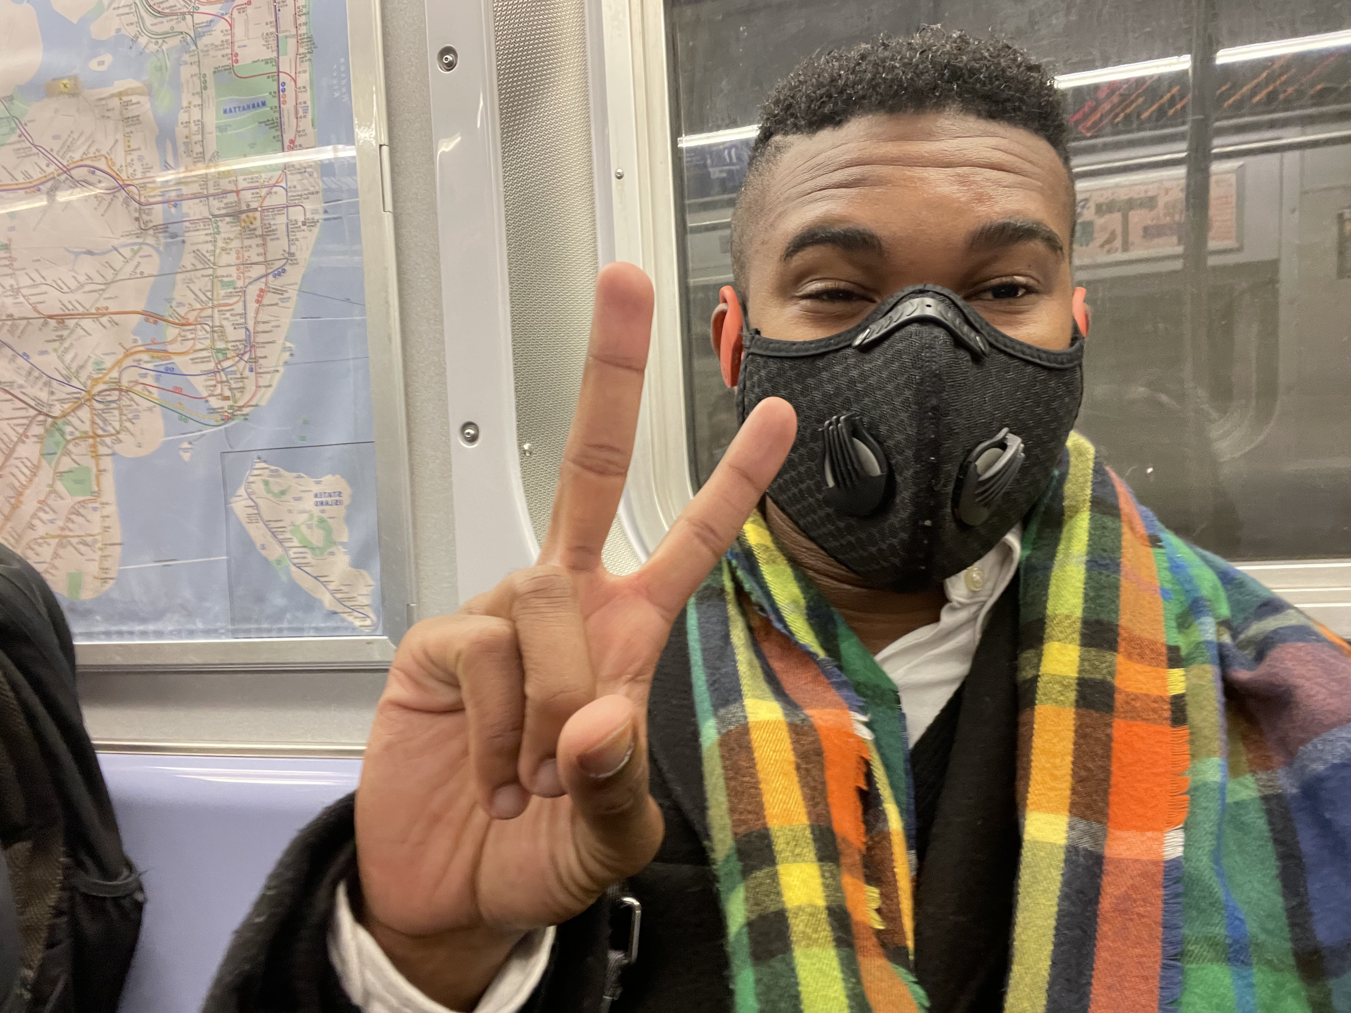
So yeah... Covid happened, it wasn't just a blip
We were all there, we remember the face mask, the double face mask, the double face mask under a face shield and the nervous feeling of whether or not to wash our cereal boxes from the door dash drop off. It was early 2020, and the world hit pause. For me however, it sped up & I moved to New York City, a leap into the unknown during one of the most uncertain times in our lifetime.
COVID-19 wasn’t just a health crisis — it was a mental, emotional, and social reckoning.
I’d like this project to be more than data but a mirror. This project is about the unseen struggles people carried behind closed doors — in bedrooms, kitchens, and makeshift home offices that were really just a closest.
We often hear the numbers. But this is a story about people.

Slide 4
What Are We Looking At?
📊 Source: Self-reported global mental health data
🔢 Sample Size: 824 anonymous responses
🌍 Demographics: All ages, genders, and occupations across various countries
📅 Timeframe: Data collected during the COVID-19 pandemic
🧵 Key Topics Covered:
Mood swings
Coping struggles
Quarantine duration
Mental health history
Occupation, gender, and age

Slide 5
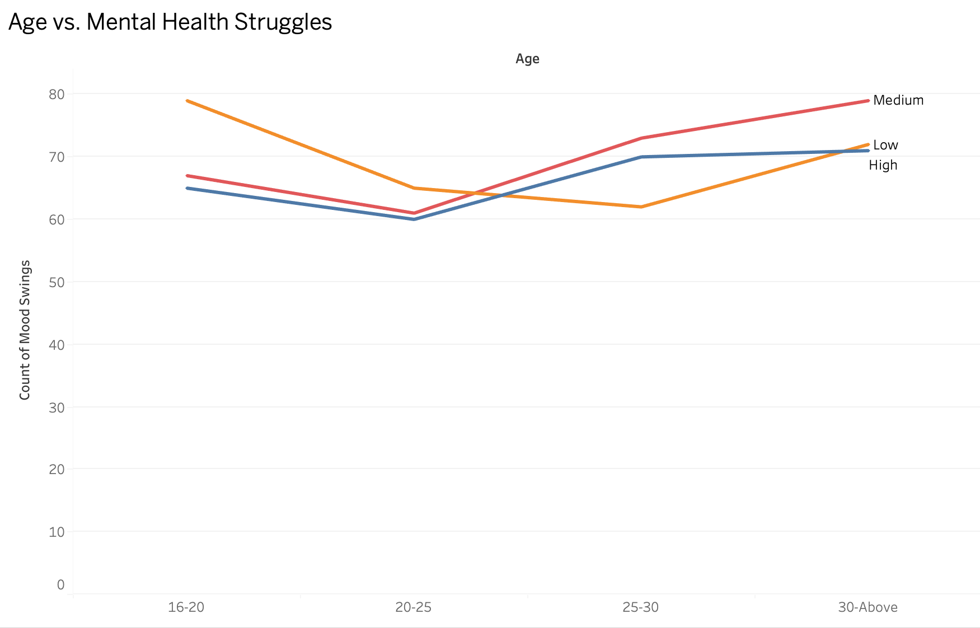
The data shows that younger individuals (ages 16–25) reported higher instances of “Medium” mood swings — a signal of persistent emotional fluctuation.
These weren't dramatic breakdowns. These were the quiet, subtle effects of isolation, uncertainty, and delayed milestones.
Older age groups showed steadier responses, suggesting experience or economic stability may have played a role in resilience.
When I saw this chart, it reminded me of my own transition to NYC during the pandemic — I was in that middle space too. Not in crisis, but not calm either.

Slide 6
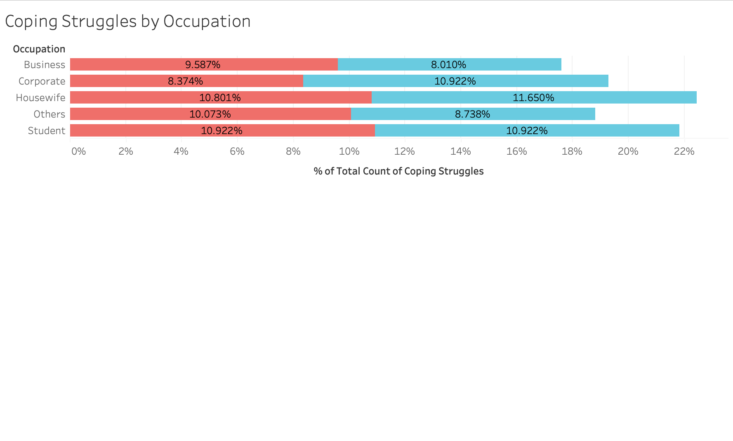
Struggle Isn’t Always Visible — But It’s There
Those with high-paying or structured jobs didn’t necessarily cope better. Corporate employees and students both reported major emotional challenges. This data proves that emotional distress didn’t discriminate by income — status didn’t shield anyone from pandemic stress.
A lot of people assume money or employment type protects your mental health. This chart shows otherwise. Even those in structured roles, with stable pay, struggled to cope. And students? They were hit just as hard, if not harder.

Slide 7
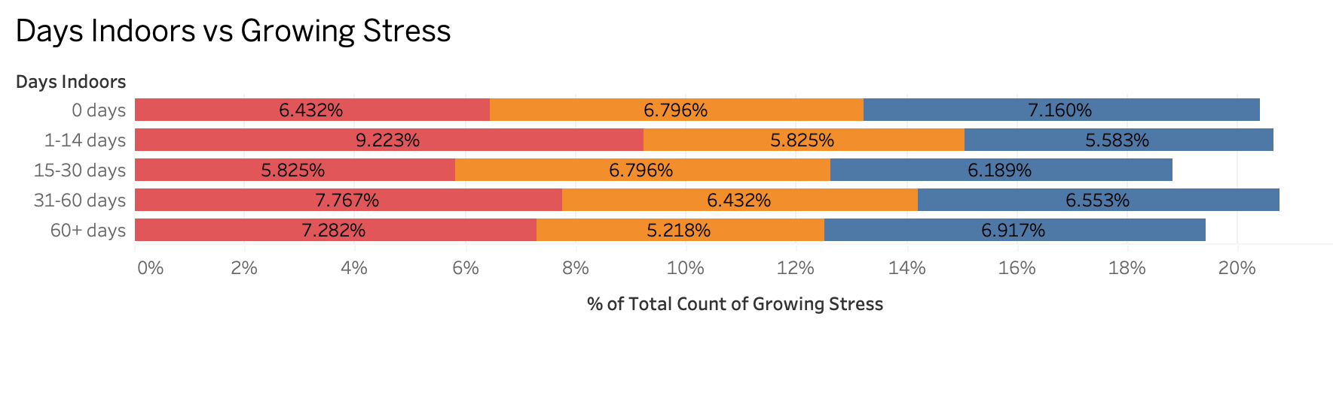
The Longer We Waited, The Heavier It Got
The longer someone remained in isolation, the more likely they were to report growing stress. People who stayed indoors for 60+ days showed the highest levels of stress — a reminder that social isolation has lasting effects. Time was not a healer here. It was a pressure cooker.
This one feels universally relatable. The first few days were fine, maybe even restful. But as weeks turned to months, stress grew. This slide reflects that — the cumulative weight of waiting, alone.

Slide 8
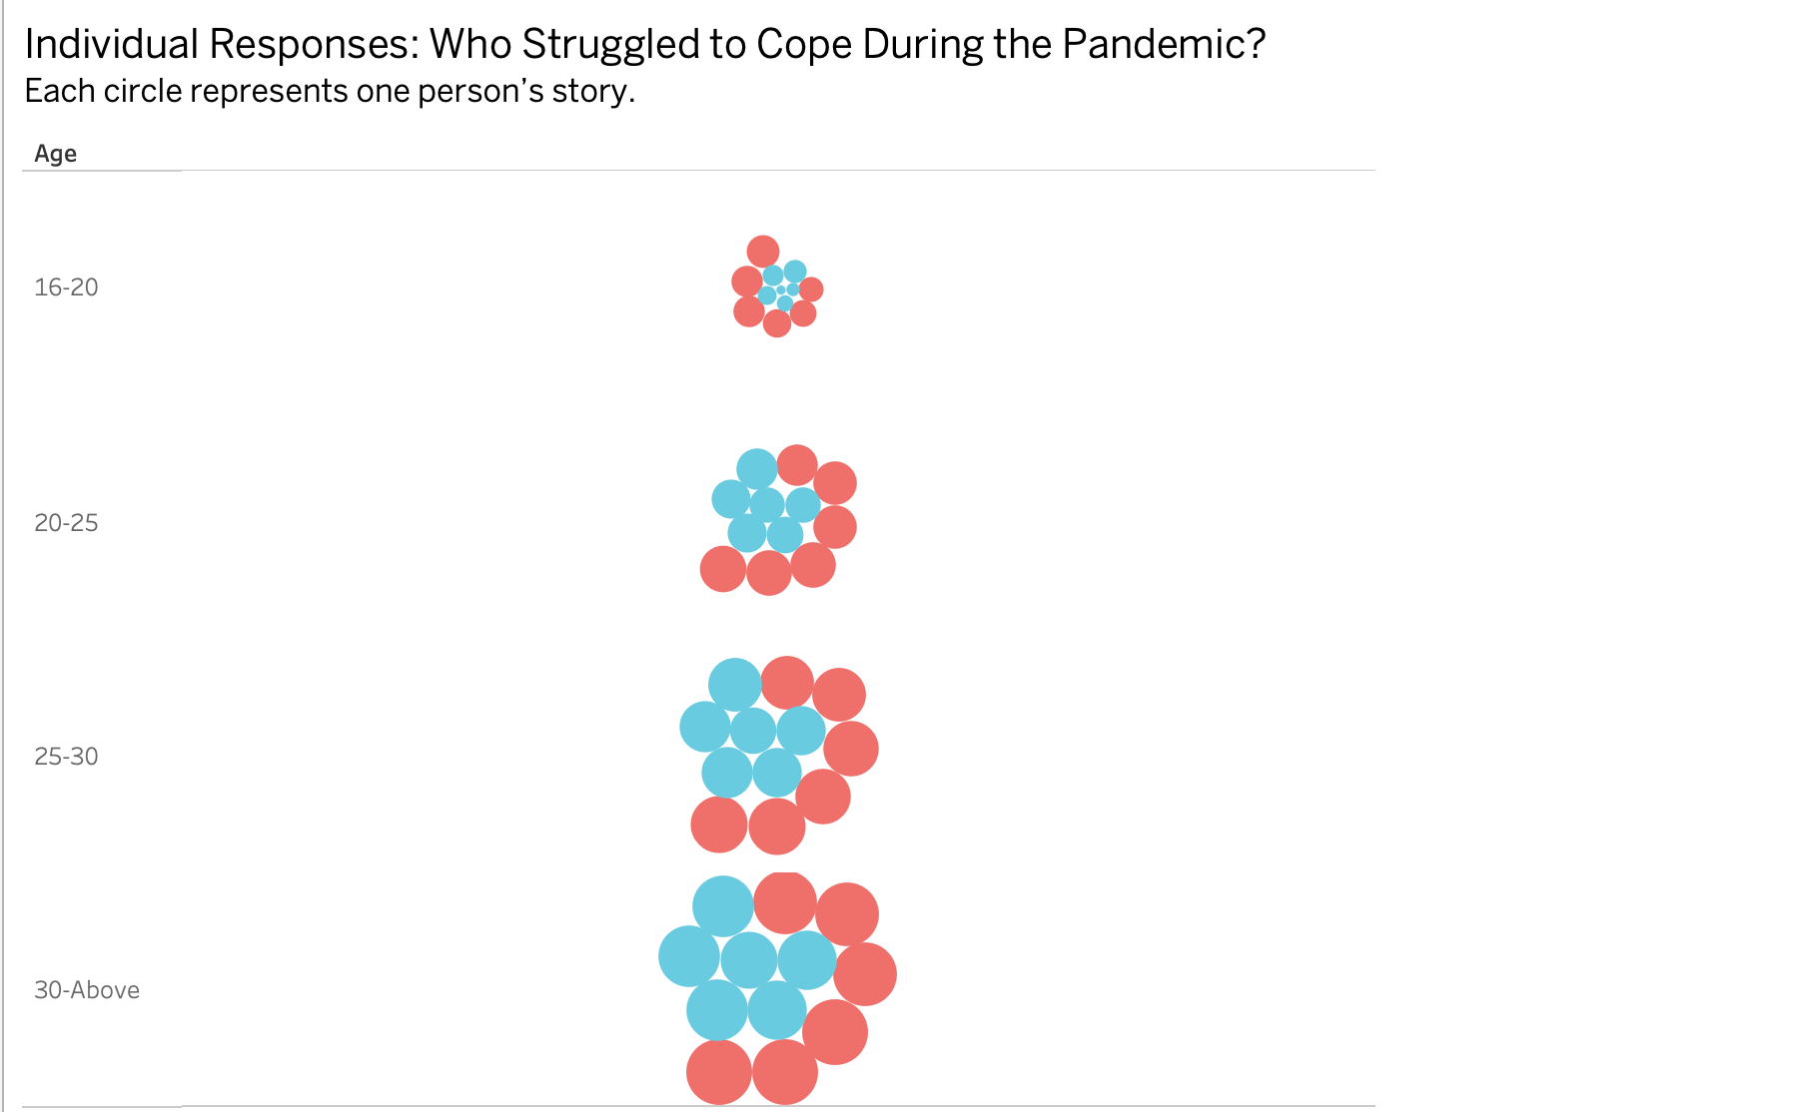
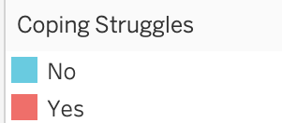
Who Struggled to Cope?
Each circle here represents a group of people.
Some are male, some female. Some coped, others didn’t. But what’s clear is that everyone carried something.
We often compare, judge, or generalize. But when we look closer, the differences fade — we’re all just working together to survive the same craziness.
This is probably my favorite chart. It doesn’t give you percentages or predictive models — it just shows people. And you realize... we’re not that different. We all carry weight, we all respond to uncertainty, and we all need care.

Slide 9
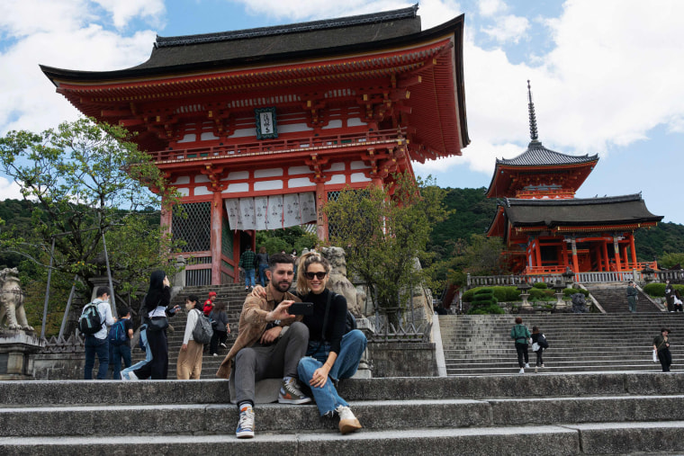
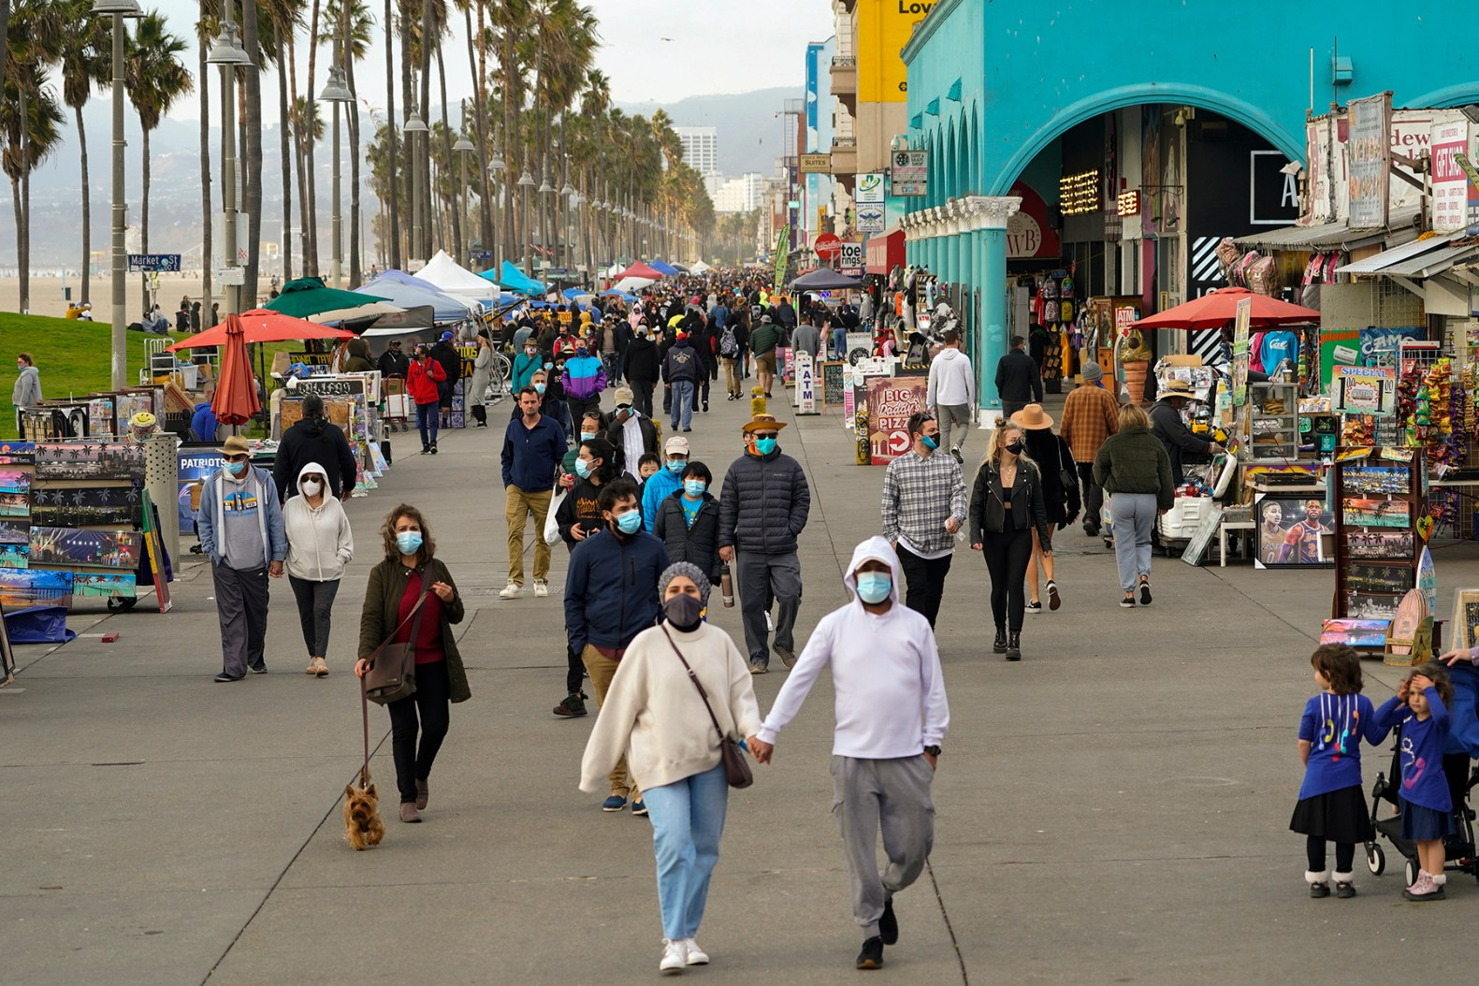
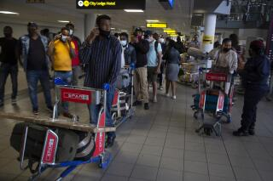
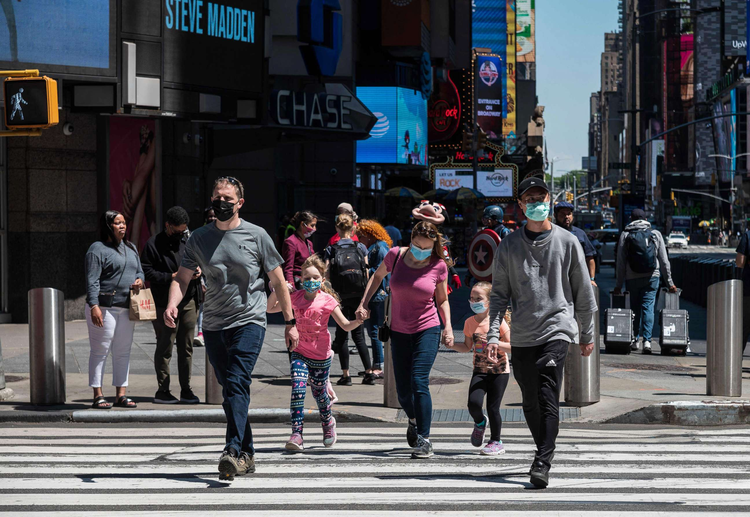
Throughout it all we made it through!
This wasn’t just a historical blip. These effects are still with us. And we’re not as different from each other as we might think.
But knowing that? That’s powerful. Because it means we have the opportunity to listen more, judge less, and support each other better.
Behind every dot, chart, and stat is a person. And through understanding, we can shape a more connected, more compassionate future.

